Slide 1

Database Processing: Fundamentals, Design, and Implementation
15th Edition
Week #5
Part 2B
Introduction to Structured Query Language

Slide 2
SQL Subqueries versus SQL Joins
SQL subqueries and SQL joins both process multiple tables.
An SQL subquery can only be used to retrieve data from the “top table.”
An SQL join can be used to obtain data from any number of tables, including the “top table” of the subquery.
In Chapter 8, we will study the correlated subquery. That kind of subquery can do work that is not possible with joins.

Slide 3
SQL Queries on Recursive Relationships (1 of 3)
Recursive means that something recurs or repeats.
A recursive procedure (in computer programming languages) is a block of code that calls itself.
A recursive relationship (in database structures) is a relationship between two columns in the same table.

Slide 4
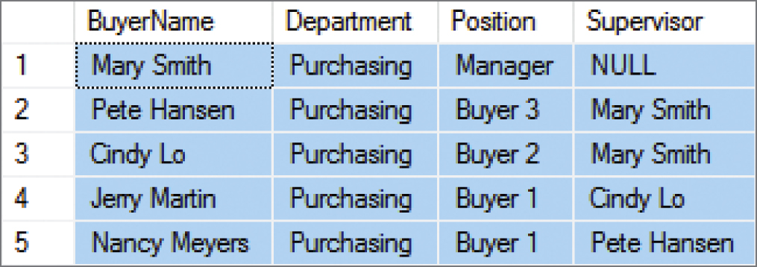
SQL Queries on Recursive Relationships (2 of 3)
In the Cape Codd Outdoor Sports data extract below, the BUYER table has a recursive relationship: the Supervisor column holds value of the BuyerName column as data and serves as a foreign key referencing BuyerName as the associated primary key.
SELECT BuyerName, Department, Position, Supervisor
FROM BUYER
ORDER BY Position DESC;

Slide 5
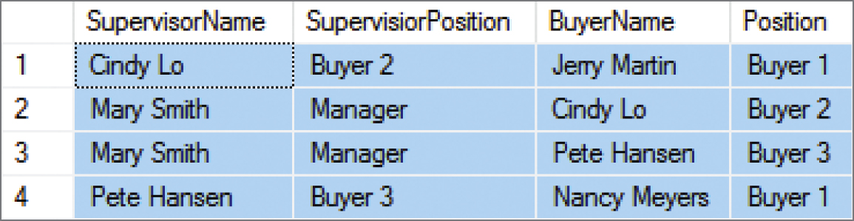
SQL Queries on Recursive Relationships (3 of 3)
The solution is to use table aliases to create two aliased versions of the same single table. Thus, the query below lists each BuyerName and that person’s Supervisor:
SELECT S.BuyerName AS SupervisorName, S.Position AS SupervisorPosition, B.BuyerName, B.Position
FROM BUYER S JOIN BUYER B
ON S.BuyerName = B.Supervisor ORDER BY S.BuyerName;

Slide 6
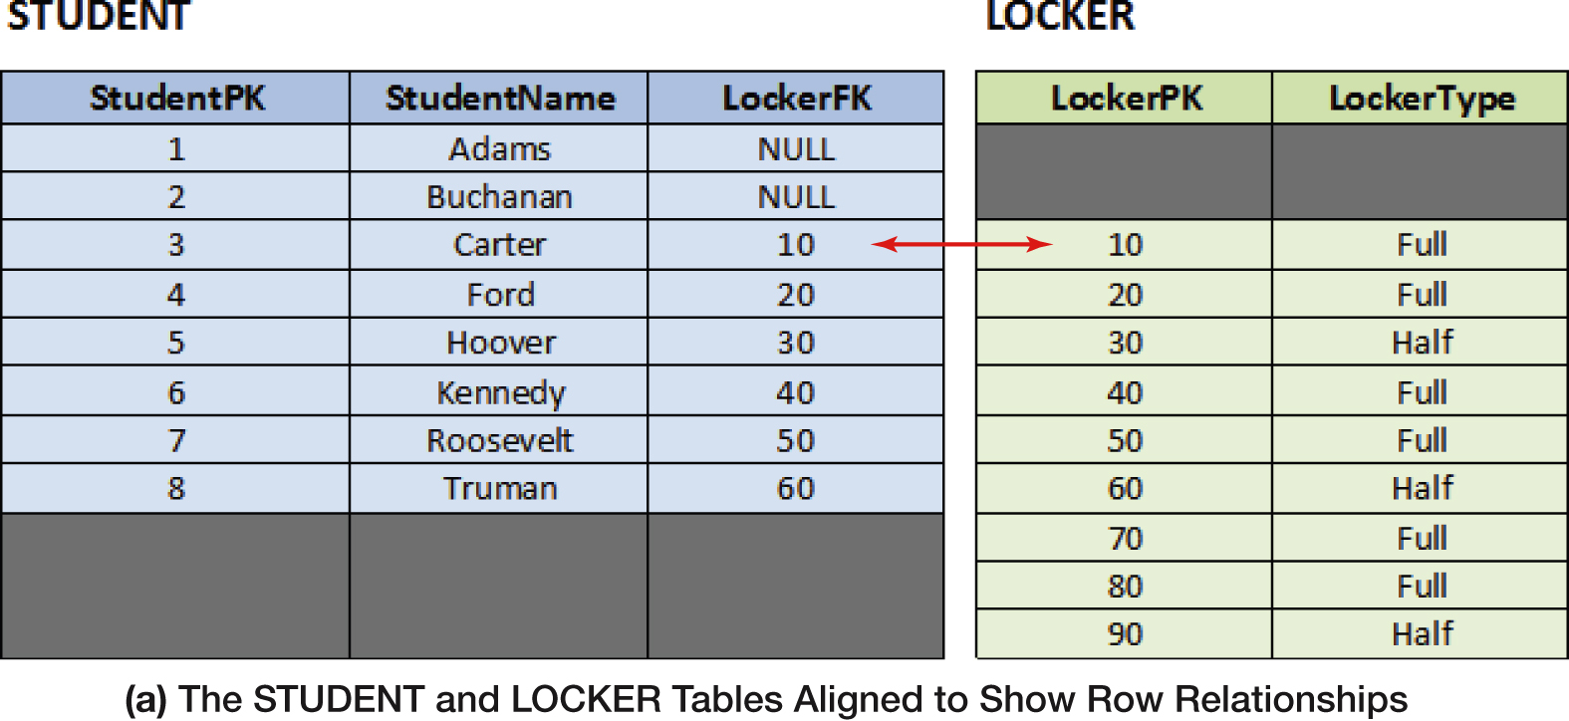
The Logic of Outer Joins – Example Tables

Slide 7
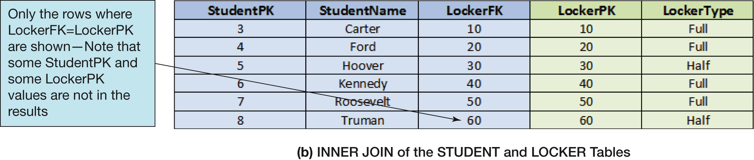
INNER JOIN (STUDENT and LOCKER Tables)

Slide 8
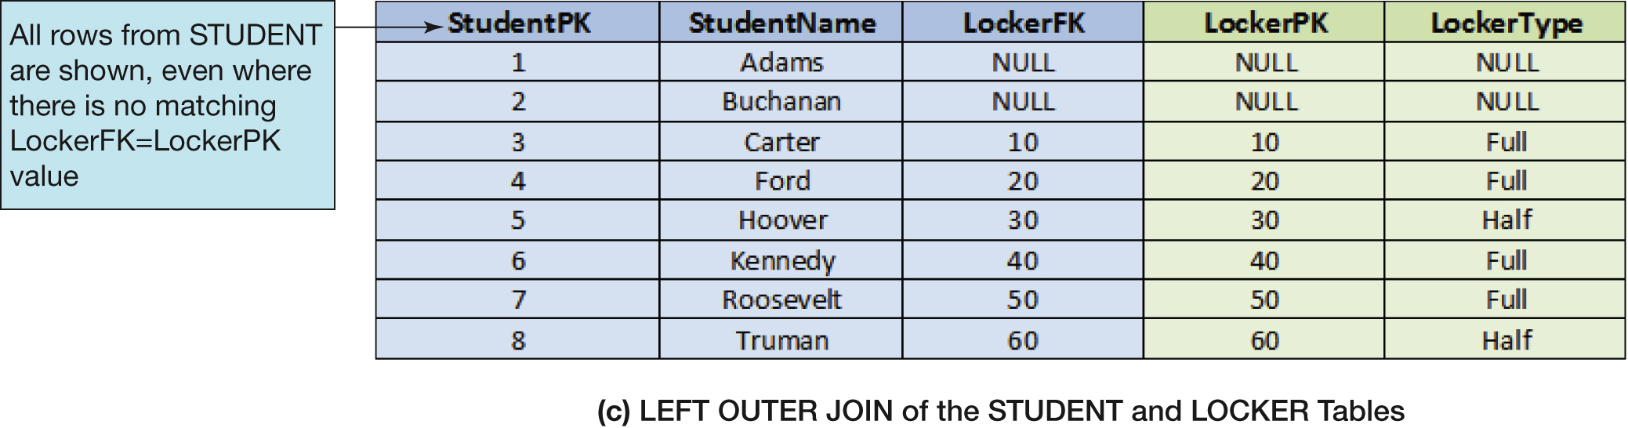
LEFT OUTER JOIN (STUDENT and LOCKER Tables)

Slide 9
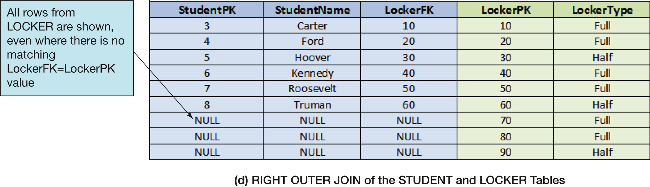
RIGHT OUTER JOIN (STUDENT and LOCKER Tables)

Slide 10
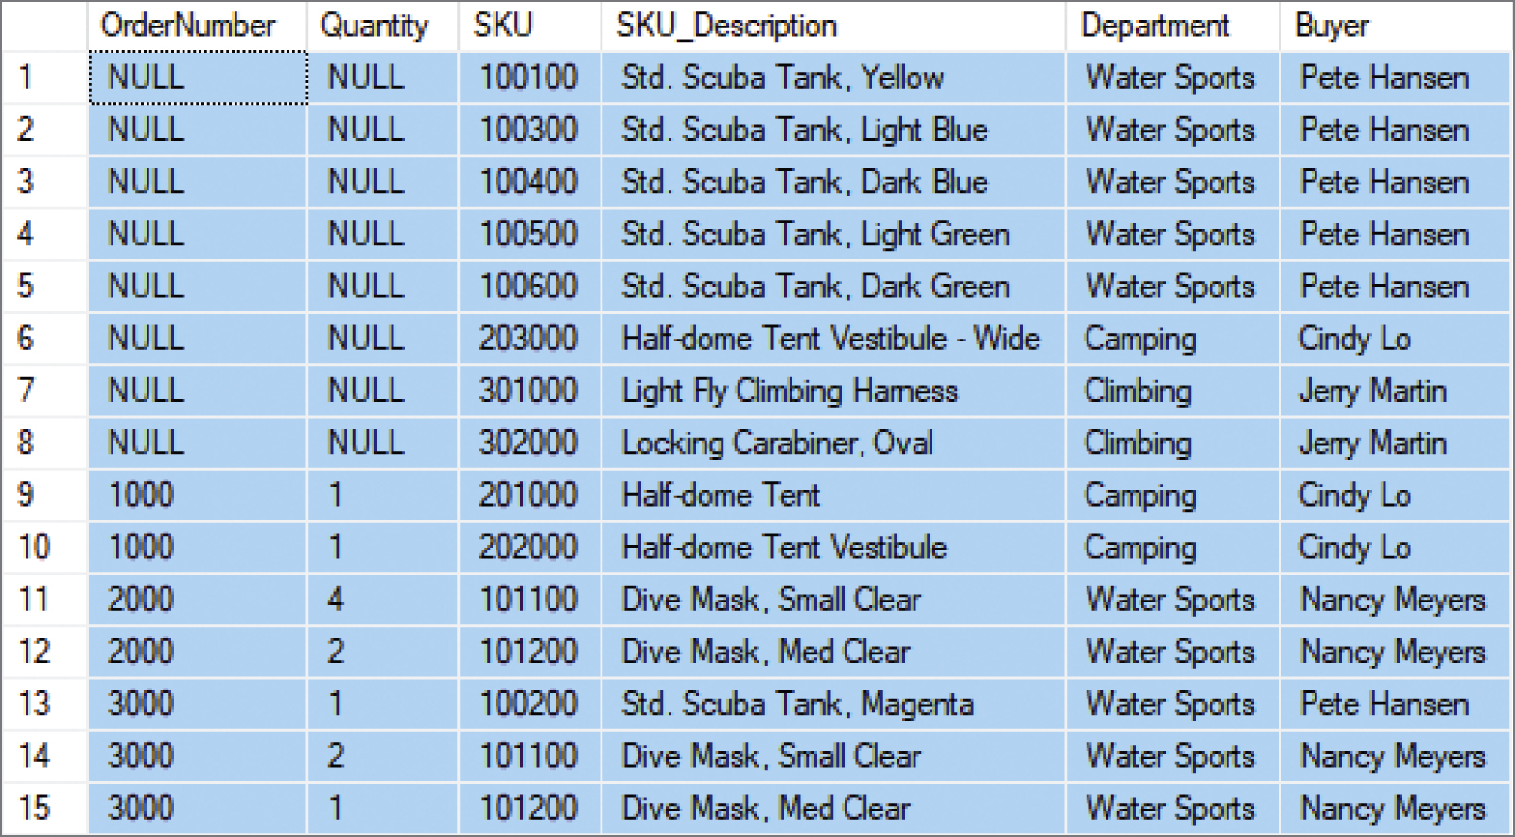
SQL RIGHT OUTER JOIN Example
SELECT OI.OrderNumber, Quantity, SD.SKU, SKU_Description, Department, Buyer
FROM ORDER_ITEM AS OI RIGHT OUTER JOIN SKU_DATA AS SD ON OI.SKU = SD.SKU
ORDER BY OI.OrderNumber, SD.SKU;

Slide 11
Mathematical Set Theory
Mathematicians use the term set theory to describe mathematical operations on sets, where a set is defined as a group of distinct items.
A relational database table meets the definition of a set, so it is little wonder that SQL includes a group of set operators for use with SQL queries.

Slide 12
Venn Diagrams (1 of 2)
Venn diagrams are the standard method of visualizing sets and their relationships.
A set is represented by a labeled circle.
A subset is a portion of a set that is contained entirely within the set.
The union of two sets represents a set that contains all values in both sets. This is equivalent to an OR logical operation (A OR B).
The intersection of two sets represents the area common to both sets. This is equivalent to an AND logical operation (A AND B).
The complement of set B in set A represents everything in set A that is not in set B. This is equivalent to a logical operation using NOT (A NOT B).

Slide 13
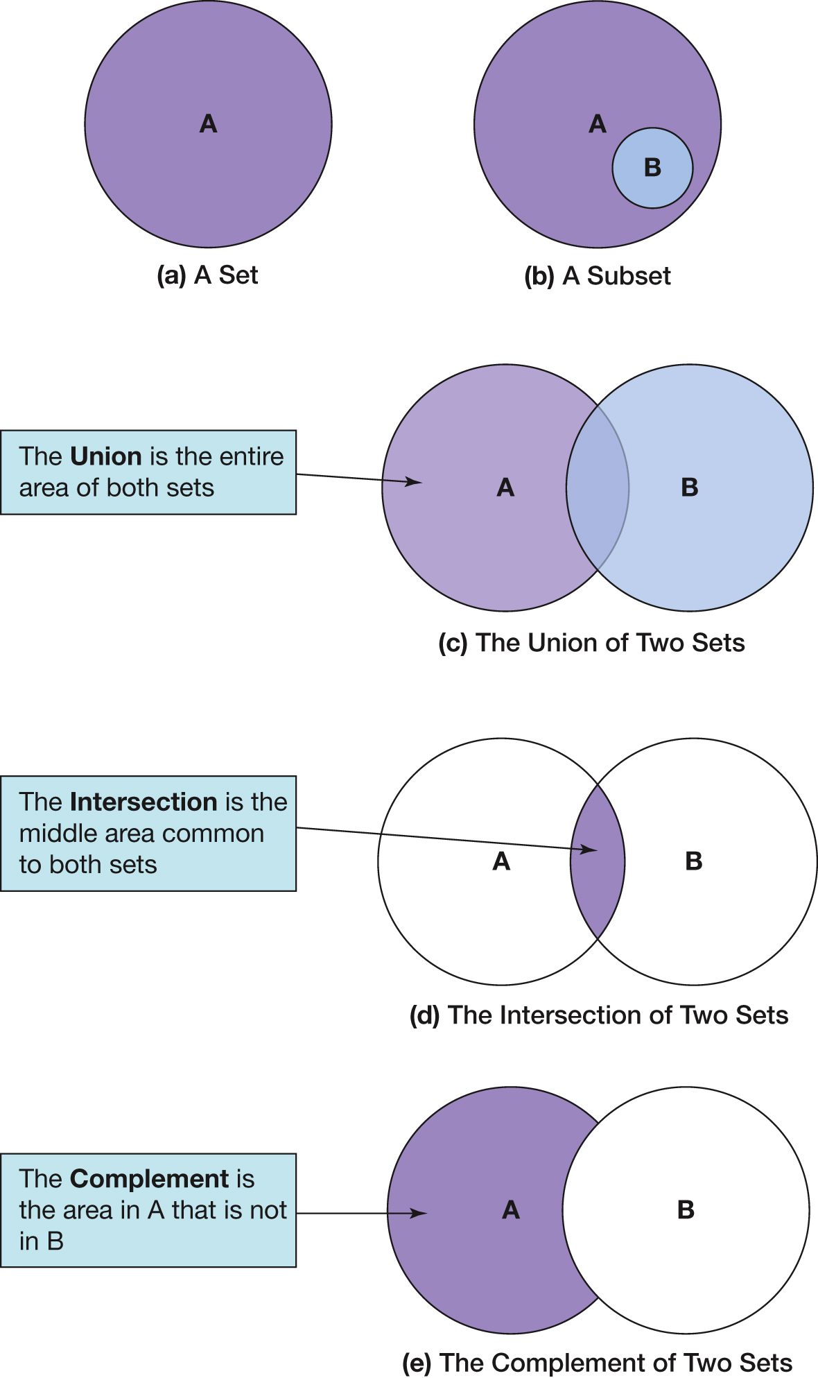
Venn Diagrams (2 of 2)

Slide 14
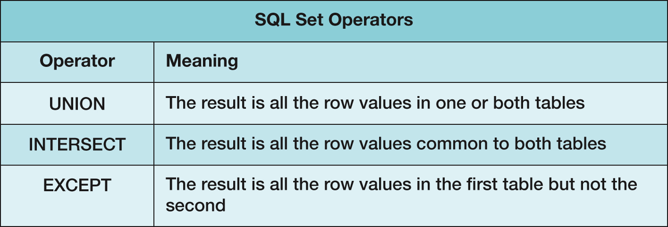
SQL Set Operators
Note that in order to use SQL set operators, the table columns involved in the operations must be the same number in each SELECT component, and corresponding columns must have the same or compatible (e.g., CHAR and VARCHAR) data types!

Slide 15
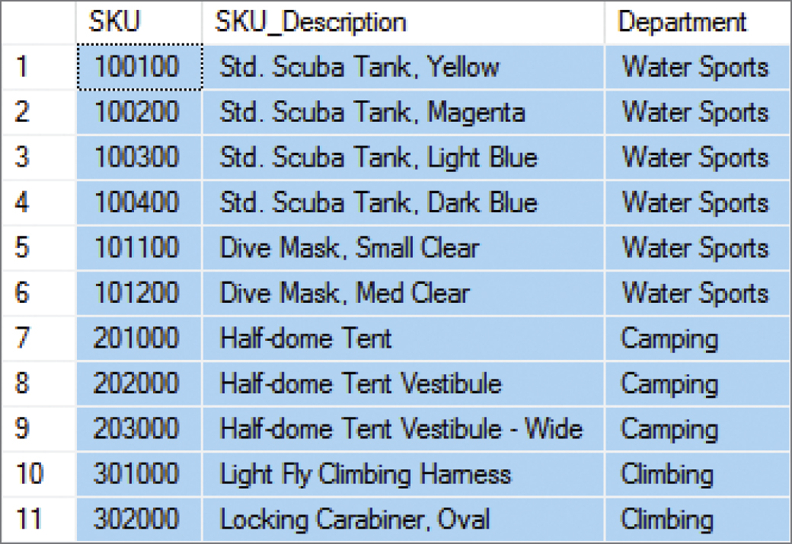
SQL UNION Operator
“What products were available for sale (by either catalog or Web site) in 2017 and 2018?”
SELECT SKU, SKU_Description, Department
FROM CATALOG_SKU_2017
UNION
SELECT SKU, SKU_Description, Department
FROM CATALOG_SKU_2018;

Slide 16
SQL ALL Keyword
If we compare the output of the query on the previous slide referring to the data in CATALOG-SKU_2017 and CATALOG_SKU_2018, we will note that there are no duplicate rows in the query output. For example, SKU 201000, the Half-Dome Tent, is actually in each table, but only appears once in the query output. If, for some reason, we wanted the duplicated rows to be displayed in the query output as well, we would simply add the SQL ALL keyword to the query:
SELECT SKU, SKU_Description, Department
FROM CATALOG_SKU_2017
UNION ALL
SELECT SKU, SKU_Description, Department
FROM CATALOG_SKU_2018;

Slide 17
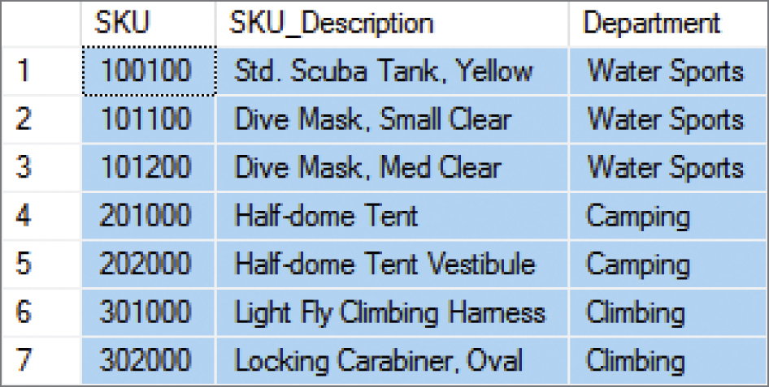
SQL INTERSECT Operator
“What products were available for sale (by either catalog or Web site) in both 2017 and 2018?” [MySQL 5.6 does not support the INTERSECT Operator]
SELECT SKU, SKU_Description, Department
FROM CATALOG_SKU_2017
INTERSECT
SELECT SKU, SKU_Description, Department
FROM CATALOG_SKU_2018;

Slide 18
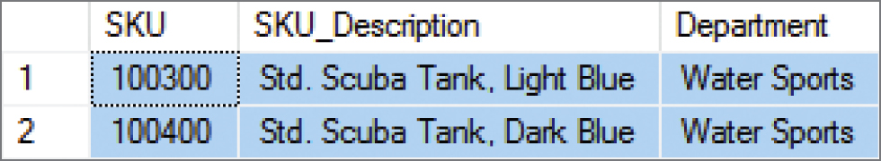
SQL EXCEPT Operator
“What products were available for sale (by either catalog or Web site) in 2017 but not in 2018?” [Oracle Database calls this the SQL MINUS operator, and MySQL 5.6 does not support this operation]
SELECT SKU, SKU_Description, Department
FROM CATALOG_SKU_2017
EXCEPT
SELECT SKU, SKU_Description, Department
FROM CATALOG_SKU_2018;

Slide 19
Database Processing Fundamentals, Design, and Implementation (15th Edition)
End of Presentation:
Week #5
Part 2B

